Slide 1
Learning in Neural Networks
Anders Krogh
Center for Health Data Science
University of Copenhagen

Slide 2
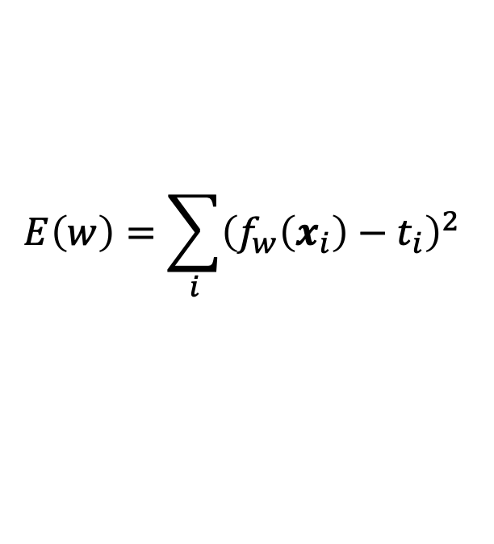
Loss function
We used the squared error to quantify the error of a neural network
This is also called the loss function or cost function
The choice of loss function depends on the type of problem
Squared error is often used for regression problems
Regression: predict (continuous) variables y from other variables x
Maximum likelihood estimation
Many loss functions correspond to a negative log likelihood:
The higher the probability of your data, the better
Squared loss corresponds to a model with normally distributed errors
$$E\left(w\right)=\sum_{i}{{\left(f_{w}\left(x_{i}\right)−t_{i}\right)}^{2} }$$
Loss = –log P(data)

Slide 3
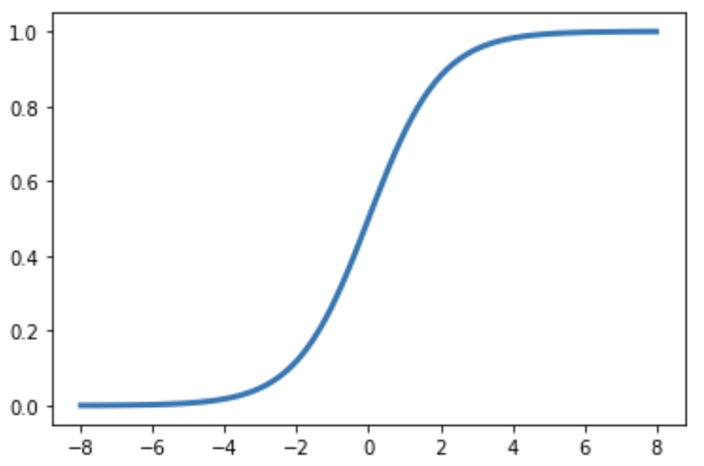


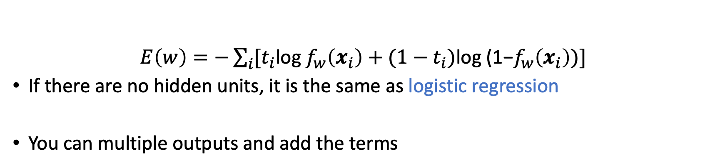
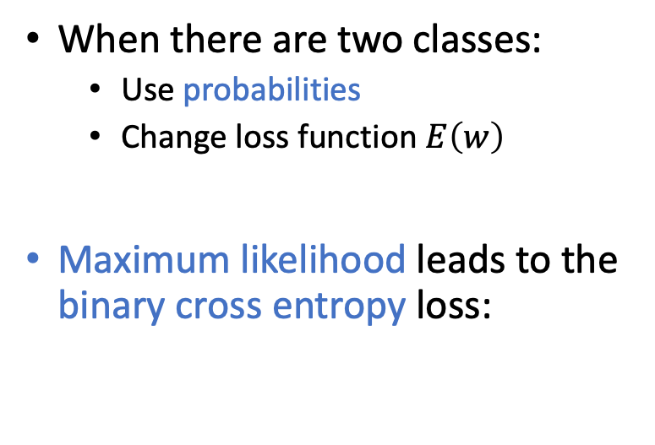
Classification
P(cat)=1
When there are two classes:
Use probabilities
Change loss function $E\left(w\right)$
Maximum likelihood leads to the binary cross entropy loss:
Sigmoid output
P(cat)=0
$E\left(w\right)=−\sum_{i}{{[t}_{i}\text{log} f_{w}\left(x_{i}\right)+}$ ${(1−t}_{i})\text{log}\text{ (1−}f_{w}\left(x_{i}\right))]$
If there are no hidden units, it is the same as logistic regression
You can multiple outputs and add the terms

Slide 4
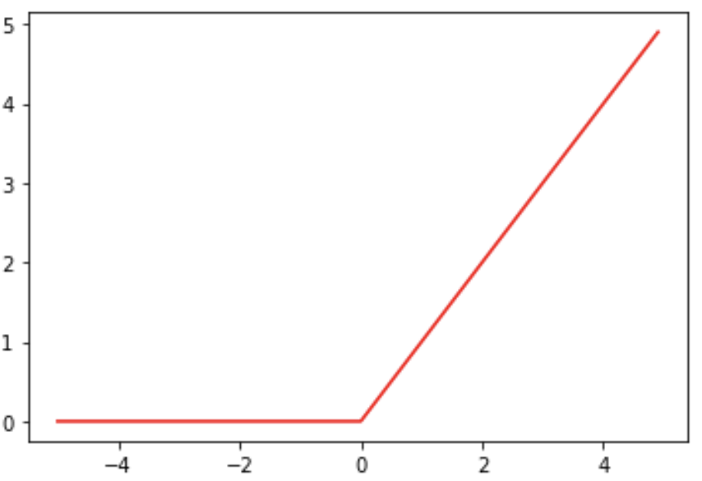
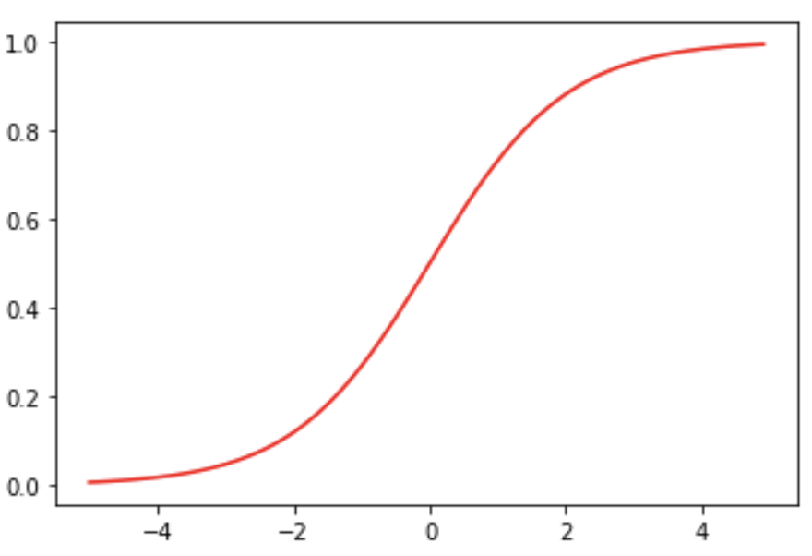
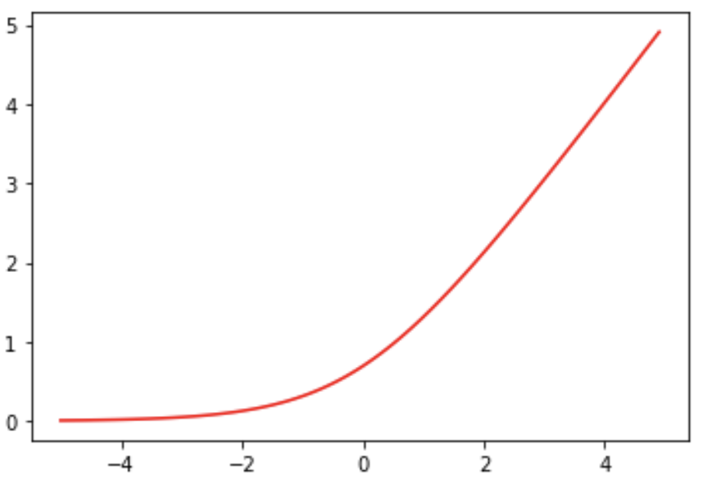
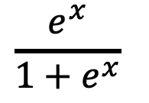
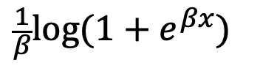
Activation functions
ReLU: Rectified Linear Unit
Often used for hidden
units
Linear (or no activation)
Used for unbounded continues values (temperature, distance, …)
Sigmoid is mostly
used to output probabilities for binary outcomes
Softplus
is a smooth replacement for ReLU
$$\frac{e^{x}}{1+e^{x}}$$
$$\frac{1}{β}log{(1+e^{βx})}$$

Slide 5
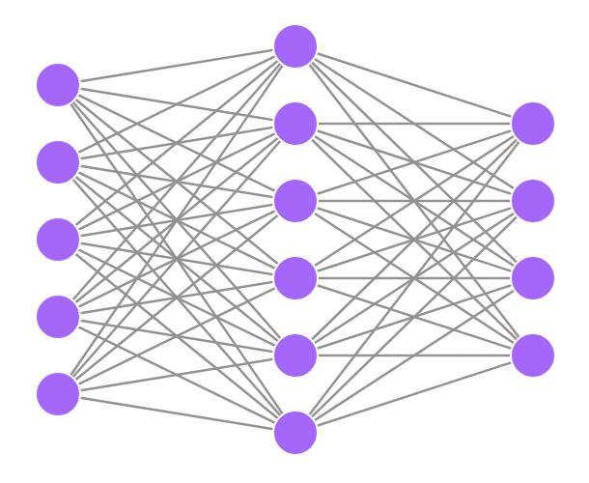


What if we have multiple classes?
Sigmoid for two classes
Output
class
1
P(class 1)
2
Input
3
P(class 0) = 1–P(class 1)
4
We would like the network to output the probability of each class
Neural net drawing made at http://alexlenail.me/NN-SVG/index.html

Slide 6
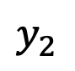
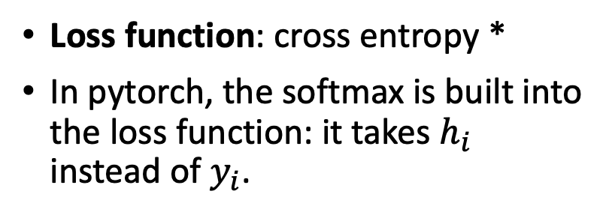
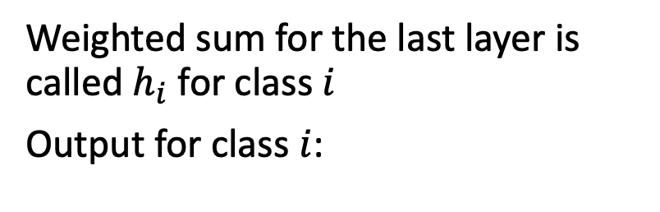
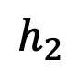
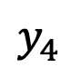
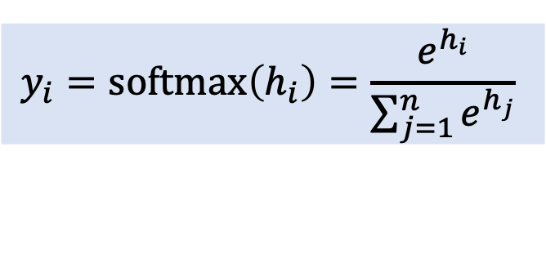
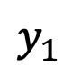
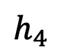
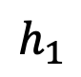
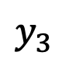
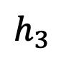
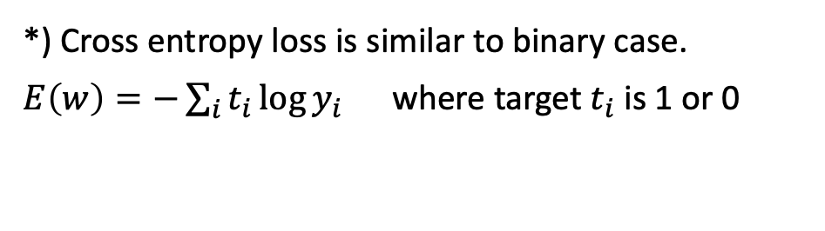
Multiple classes: Softmax
Use the softmax function to ensure probabilities sum to one
Weighted sum for the last layer is called $h_{i}$ for class $i$
Output for class $i$:
Output
class
$$y_{i}=softmax\left(h_{i}\right)=\frac{e^{h_{i}}}{\sum_{j=1}^{n}{e^{h_{j}}}}$$
$h_{1}$
1
$$y_{1}$$
$h_{2}$
2
$$y_{2}$$
Loss function: cross entropy *
In pytorch, the softmax is built into the loss function: it takes $h_{i}$ instead of $y_{i}$.
Input
$h_{3}$
3
$$y_{3}$$
$h_{4}$
4
$$y_{4}$$
*) Cross entropy loss is similar to binary case.
$E\left(w\right)=−\sum_{i}{t_{i}\log{y_{i}}}$ where target $t_{i}$ is 1 or 0

Slide 7
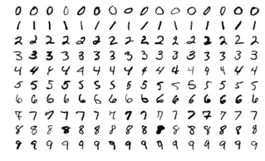
A neural network trained on the famous MNIST dataset
Open the notebook called MNISTexample
Image from https://en.wikipedia.org/wiki/MNIST_database

Slide 8
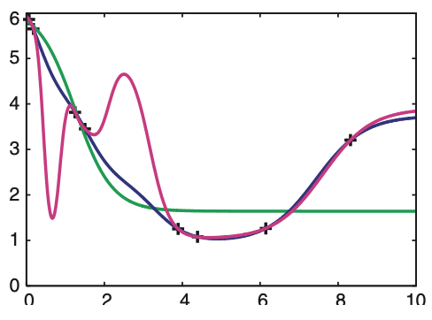
Over-fitting and generalization
Many parameters and few training data leads to over-fitting
If the network over-fits, it cannot generalize
To generalize means to be able to predict on unseen (test) data
+
training set
1 hidden unit
10 hidden
20 hidden
over-fitting
“under-fitting”
From A Krogh (2008) Nat. Biotech. 26, p. 195

Slide 9
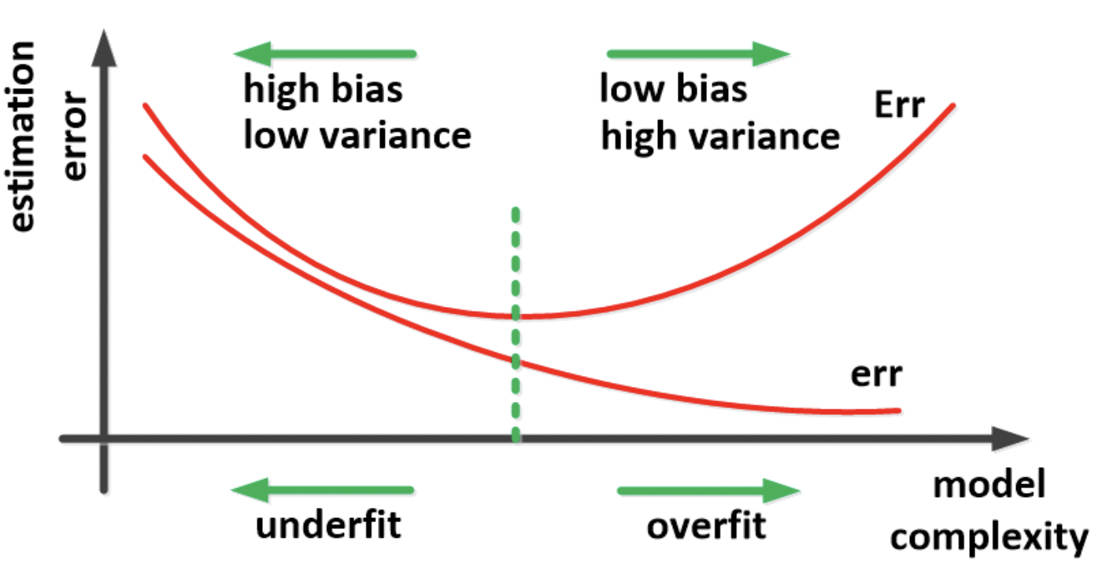
Over-fitting and generalization
Optimal model
Test error
Train error
Figure adapted from Ghojogh & Crowley (2019). https://arxiv.org/abs/1905.12787

Slide 10
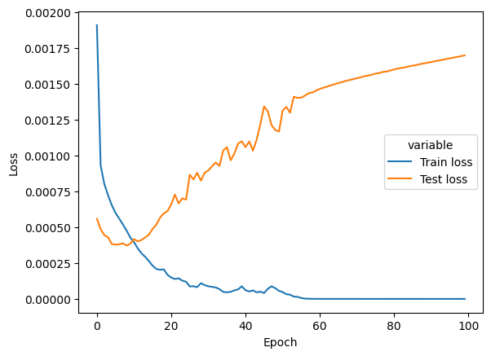
Over-fitting
If the test error (loss) is larger than the training error, there is over-fitting
A typical sign of over-fitting:
Test error starts to grow while training error is still decreasing
Training network on 30000 images from MNIST

Slide 11

Dealing with over-fitting
The network size can be decreased if it over-fits (e.g. fewer hidden units)
A weight decay* can mitigate over-fitting (other similar regularization techniques exists)
Early stopping: Chose the network with lowest validation error
Drop-out: A method that randomly removes hidden units. Increases robustness
Weight decay: a term $λw$ is subtracted from a weight $w$ in each iteration. $λ$ is normally small, 10⁻² to 10⁻⁶

Slide 12
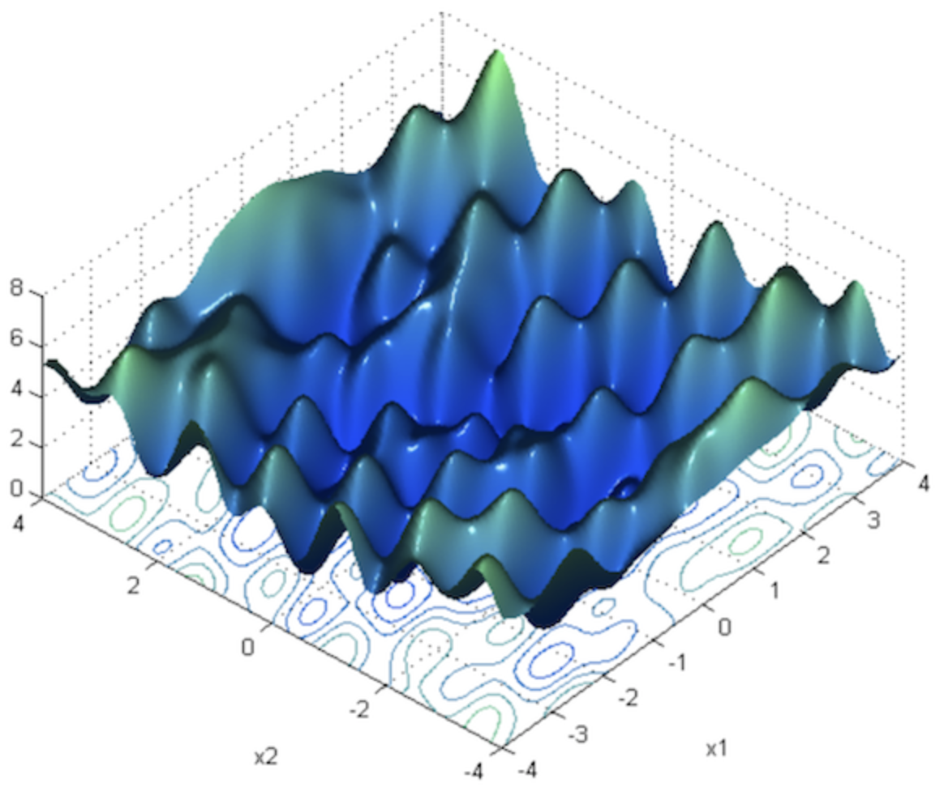
Local minima of the loss
For complex networks the loss has multiple local minima
Plain gradient descent does not work well
Stochastic gradient descent use “mini batches”
The gradient is calculated over a random sample of a certain size – the batch size
For each cycle through the training set (epoch), the network is updated many times instead of just one
Because of the randomness it can better escape local minima and has turned out to be much more efficient
There are many other “tricks”. Many of these are combined in the popular optimizer called Adam
Figure copied from: https://towardsdatascience.com/neural-network-optimization-7ca72d4db3e0

Slide 13
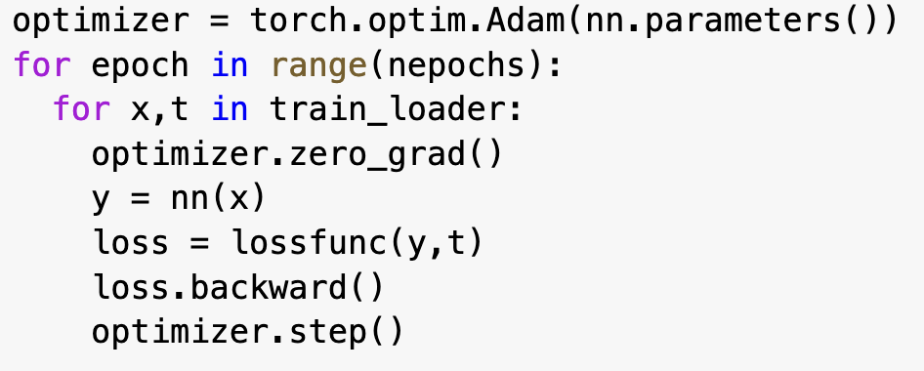
The optimizer
Example of code using the Adam optimizer:
In plain stochastic gradient descent (torch.optim.SGD) you need to set parameters (learning rate and momentum)
The Adam optimizer is usually a better choice
It automatically adapts the learning rate and momentum in clever ways
It is based on SGD and uses mini-batches
you can set a weight decay
You can set parameters in Adam, such as
learning rate (e.g. “lr=1.e-4”)
“weight_decay=1.e-5”

Slide 14
All the choices you have to make …
There are many parameters you can vary in a Neural Network.
It is a good idea to make an initial “grid search” where you systematically test performance by varying
the number of hidden layers and their size
other parameters one by one
This is sometimes done on a reduced data set and or with quite few iterations
There are also packages that can help with optimizing parameters

Slide 15
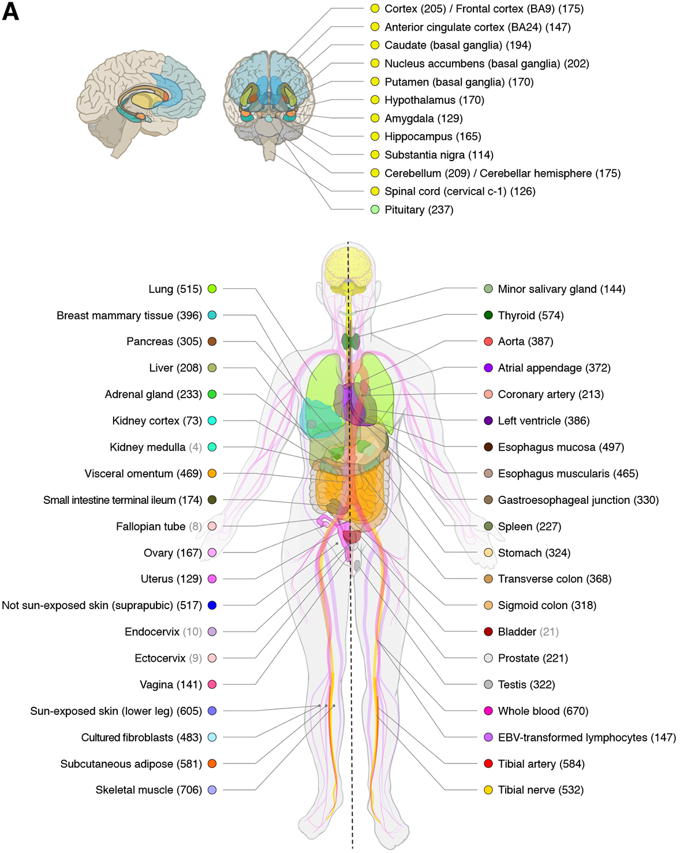
Exercise with gene expression data
RNA-seq is a great use-case for Machine Learning algorithms:
High dimensional data
Many cellular pathways are highly correlated
Tissue specific
Big datasets available (GTex)
The exercise:
Can a neural network capture the information encoded on gene expression and detect tissues?
In the exercise we will build a neural network that learns the gene expression profile and is able to guess the tissue of origin
Figure adapted from the Gtex Consortium (2020). https://pubmed.ncbi.nlm.nih.gov/32913098/

